Slide 1


DATA ANALYST CERTIFICATION
Jorge Alegre Portillo

Slide 2

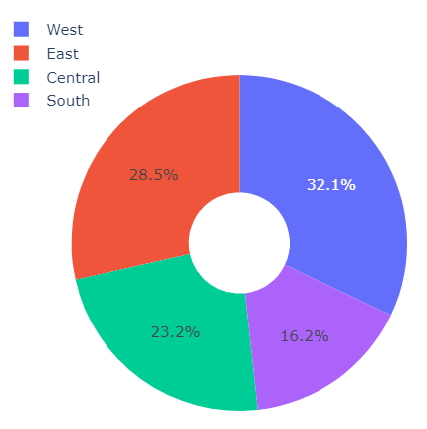

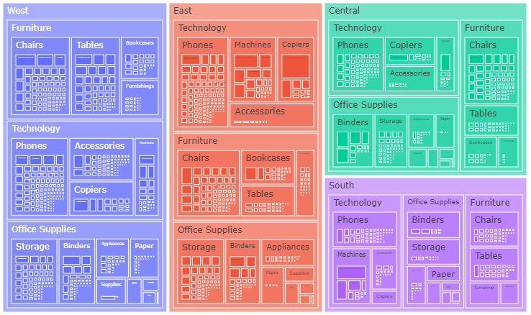
INTRODUCTION
FEATURE | COUNT
Region | 4
Category | 3
Sub-Category | 17
Ship Mode | 4
Product ID | 1862

Slide 3
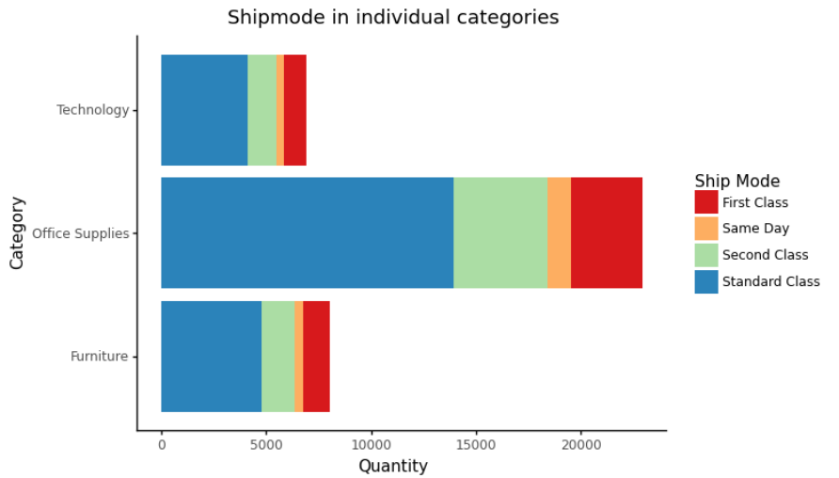
Ship mode

Slide 4
IMPUTING VALUES IN PROFIT COLUMN
We had 1993 Null values, in order to not losing observation we have used a model to impute them

Slide 5
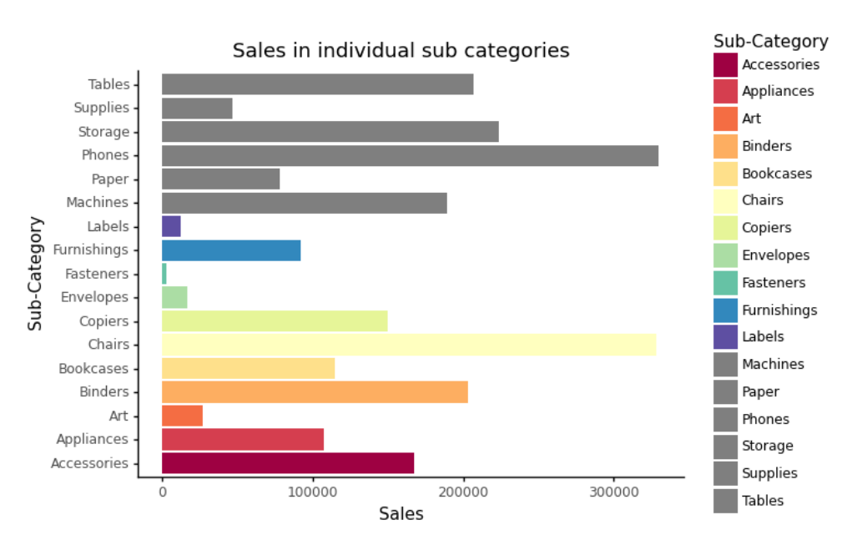
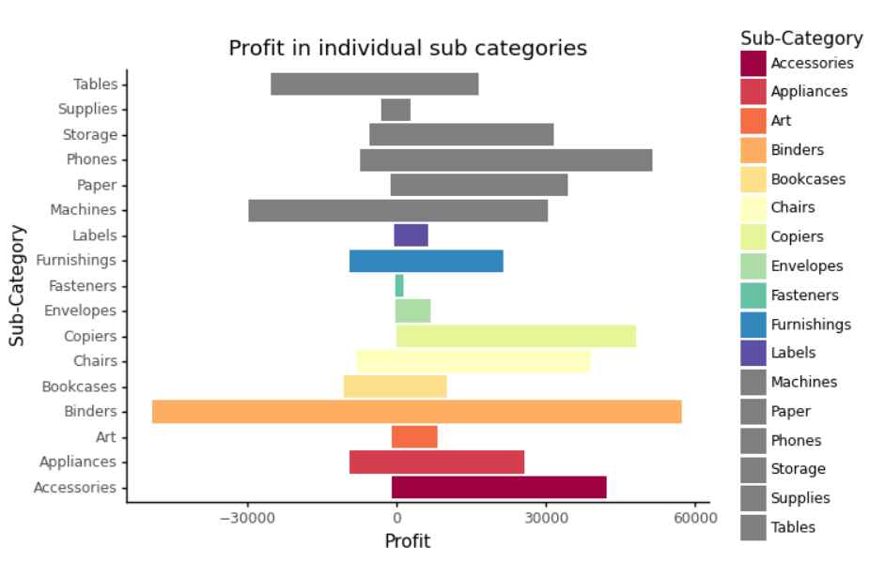
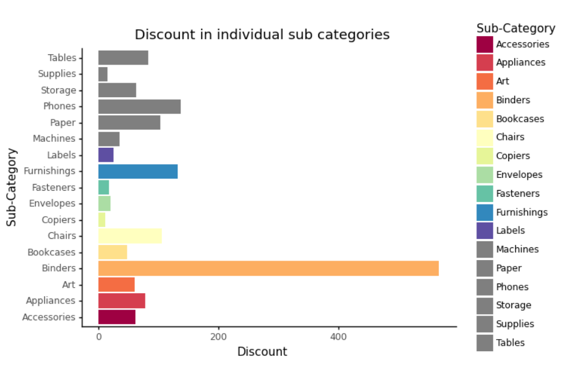
RELATIONSHIP BETWEEN SALES PROFIT AND DISCOUNT

Slide 6
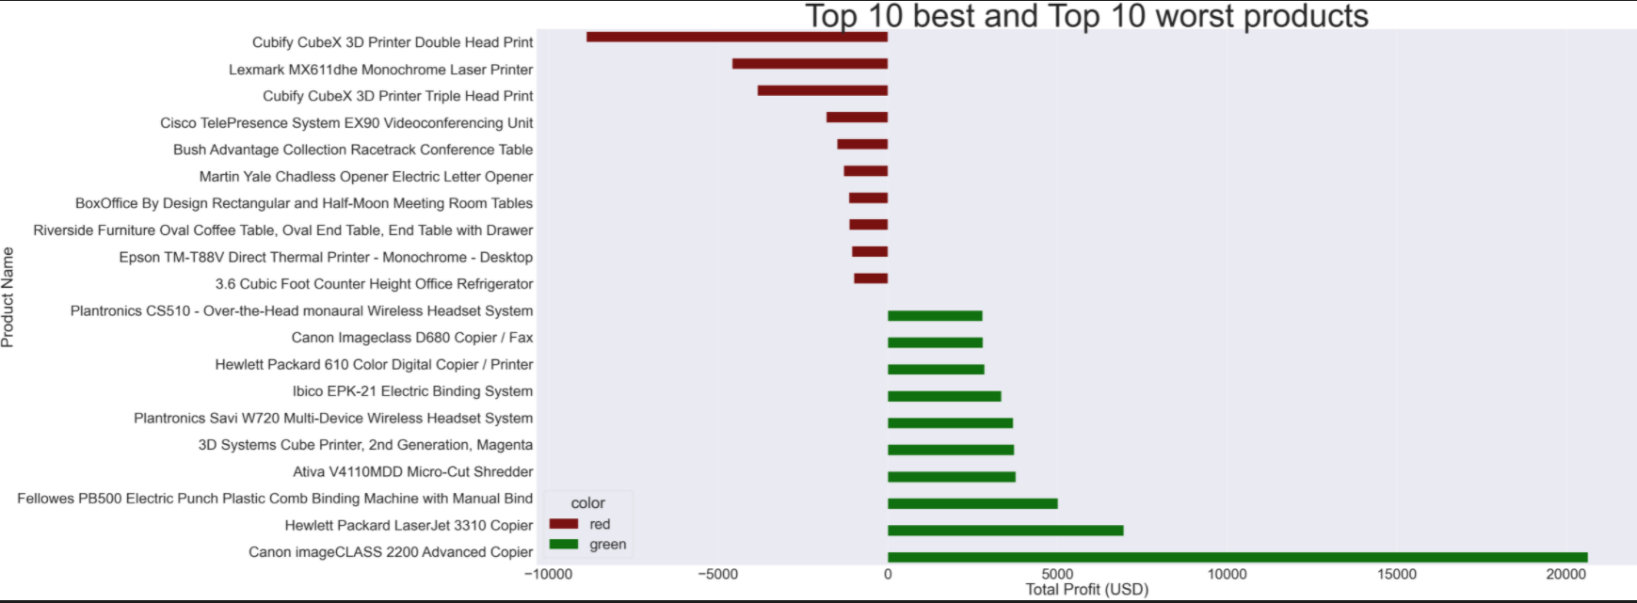
TOP 10 BEST AND TOP 10 WORST PRODUCTS NET PROFIT

Slide 7
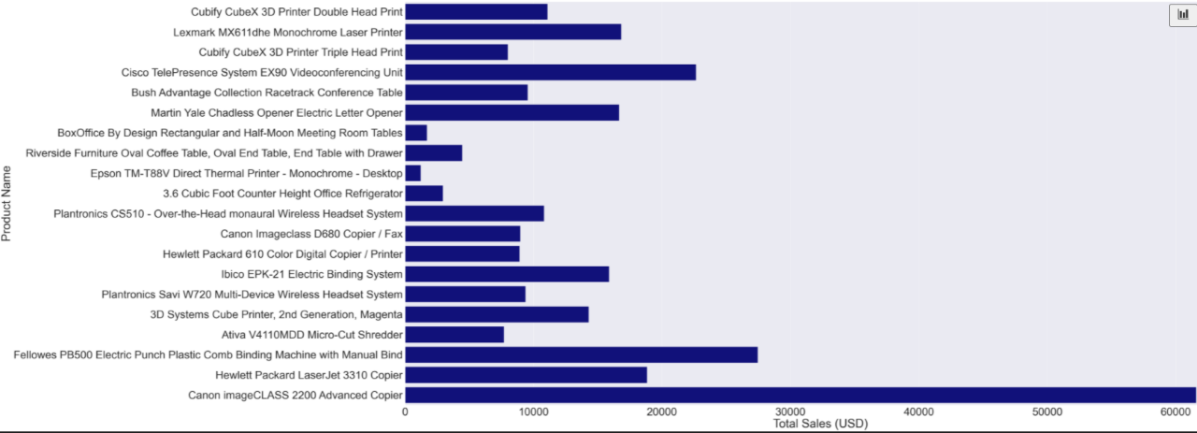
SALES

Slide 8
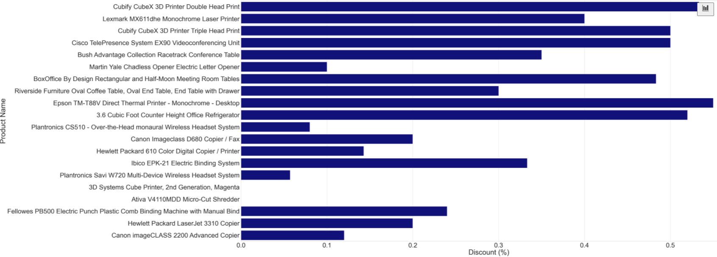
Productos que faltan en region
DISCOUNT MEAN

Slide 9
ARE THE PRODUCTS THAT DO NOT SELL IN SOME LOCATIONS?
PRODUCT ID | PRODUCT NAME | WHERE IS MISSING IN TOP 20 SALES
OFF-BI-10000545 | GBC Ibimaster 500 Manual ProClick Binding System | West
TEC-CO-10001449 | Hewlett Packard LaserJet 3310 Copier | Central
OFF-SU-10002881 | Martin Yale Chadless Opener Electric Letter Opener | West
TEC-CO-10004722 | Canon imageCLASS 2200 Advanced Copier | South

